Slide 1

Aladdin—Make AI add in!
(An automatic model intrepretability platform)
“Do you trust me?”
“Tell her the TRUTH!”
“Let’s make some magic!”
“Genie, you’re free!”

Slide 2
WHY-0
SITUATION:
The goal of science is to gain knowledge,
BUT many problems are solved with big datasets &
BLACK BOX machine learning models.
feels unexpectedly sick and asks, “Why do I feel so sick?”. He learns that he gets sick every time he eats those red berries. He updates his mental model and decides that the berries caused the sickness and should therefore be avoided.
“Why did my dog bite me even though it has never done so before?” “The dog was under stress and bit.”
Amazon recommend some product:
“It is based on frequently purchased product combinations”
rejects a loan application from applicants?
“…”

Slide 3
WHY-0
“Why did my dog bite me even though it has never done so before?” “The dog was under stress and bit.”
Amazon recommend some product:
“It is based on frequently purchased product combinations”
Rejects a loan application from applicants?
“…”
Notes:
Human desire to find meaning in the world. We want to harmonize contradictions between elements of our knowledge structures.
“Why did my dog bite me even though it has never done so before?” a human might ask. There is a contradiction between the knowledge of the dog’s past behavior and the newly made.
Another example is product recommendation. it makes sense to suggest gloves if I already have a winter hat in my shopping cart. Increasingly, Internet companies are adding explanations to their recommendations. A good example is the Amazon product recommendation, which is based on frequently purchased product combinations.
If a machine learning model rejects a loan application, this may be completely unexpected for the applicants. The explanations do not actually have to fully explain the situation, but should address a main cause.

Slide 4
Why-1: Why we should know WHY?
Knowing the ‘why’ can help you learn more about the problem, the data and the reason why a model might fail.
Provide
Allow
Change
Behavior
Reasons,
Logic
Human-friendly
explanations
Non-experts to understand
Learn More,
Why fail
…
Notes:
The reasons provide the guidelines on how to change behavior.
Understanding the reasons and logic can provide human-friendly explanations. Human-friendly explanations allow non-experts to understand complicated algorithms.

Slide 5

WHY-2
Human curiosity and learning:
When opaque machine learning models are used in research, scientific findings remain completely HIDDEN if the model only gives predictions without explanations.
Machine learning models:
can only be DEBUGGED & AUDIT when they can be interpreted
huskies OR wolves??
The classifier learned to use SNOW as a feature
for classifying images as “wolf”….
SNOW→Failures
Notes:
Consider an example of a husky versus wolf classifier that misclassifies some huskies as wolves.
The classifier learned to use snow as a feature for classifying images as “wolf”, which might make sense in terms of separating wolves from huskies in the training dataset, but not in real-world use.
Using interpretable machine learning methods, you would find that the misclassification was due to the snow on the image.

Slide 6



What-1
manage social interactions
vacuum cleaner:
“Doge”
human can understand the cause of a decision;
detecting bias
Increase social acceptance
Interpretability is the degree to which a human can understand the cause of a decision：
The higher the interpretability of a machine learning model, the easier it is for someone to comprehend why certain decisions or predictions have been made.

Slide 7

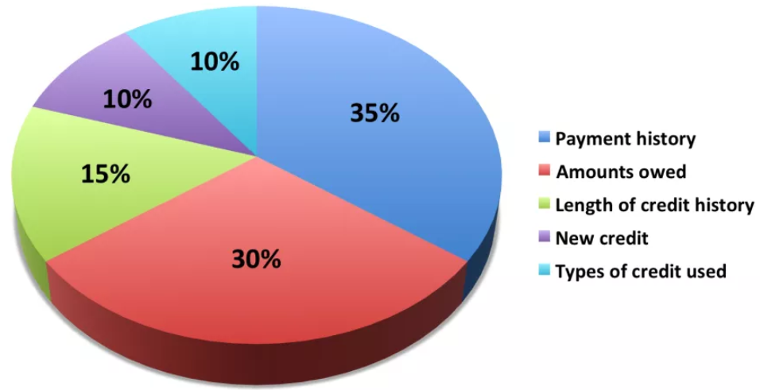
What-2
Interpretability is a useful debugging tool for detecting bias in machine learning models.
Grant loans only to people
who will eventually repay them.
Recent Negative Items on Credit Reports
Notes:
Interpretability is a useful debugging tool for detecting bias in machine learning models:
Your main goal is to grant loans only to people who will eventually repay them. It might happen that the machine learning model you have trained for automatic approval or rejection of credit applications discriminates against a minority.
This is an additional constraint that is part of your problem formulation that is not covered by the loss function the machine learning model was optimized for.

Slide 8
What-3
manage social interactions
understand the cause of a decision;
detecting bias
Increase social acceptance
Interpretability could increase social acceptance:
“when I find out that Doge has knocked over a plant while dutifully vacuuming the house”….
A machine or algorithm that explains its predictions will find more acceptance.

Slide 9
What-3
manage social interactions
understand the cause of a decision;
detecting bias
Increase social acceptance
Doge got stuck could be :
the battery was very low
that one of the wheels is not working properly
there is a bug that makes the robot go to the same spot over and over again even though there was an obstacle.
Carpet block its way→an even surface
…
Explanation are used to manage social interactions:
Notes:
These reasons (and a few more) caused the robot to get stuck, but it only explained that something was in the way, and that was enough for the owner to trust its behavior and get a shared meaning of that accident.
By the way, if the vacuum robot got stuck in the bathroom again. We have to remove the carpets each time before it got stuck again. As an explanation for the accident, the robot told us that it needs to be on an even surface.

Slide 10
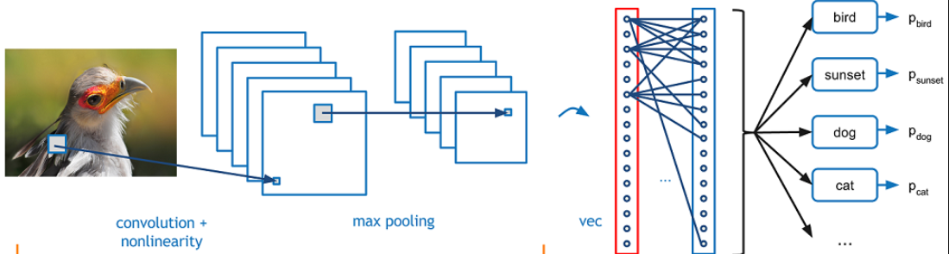
How-1
intrinsically interpretable models
Post hoc methods can also be applied to
intrinsically interpretable models.
Post hoc methods
restricting the complexity of the machine learning model
by applying methods that analyze the model after training
Each step can be evaluated
in terms of transparency
or interpretability:

Slide 11
How-2
Each step can be evaluated in terms of transparency or interpretability:
Algorithm
Transparency
Global, Holistic Model
Interpretability
Global Model Interpretability
on a Modular Level
How does the
algorithm
create the model?
How does the
trained model
make predictions?
How do parts of the model
affect predictions?
understand how the model makes decisions: based on a holistic view of its features and each of the learned components such as weights, other parameters, and structures,
Which features are important?
What kind of interactions between them take place?
For linear models:
the interpretable parts are the weights,
For trees:
it would be the splits (selected features plus cut-off points) and leaf node predictions.
Algorithm transparency only requires:
knowledge of the algorithm !
NOT the data or learned model.
Explain:
How the algorithm works:
the algorithm learns edge detectors and filters on the lowest layers
Notes:
Methods for machine learning interpretability can be classified according to various criteria.
An algorithm trains a model that produces the predictions. Each step can be evaluated in terms of transparency or interpretability.
convolutional neural networks to classify images, you can explain that the algorithm learns edge detectors and filters on the lowest layers. This is an understanding of how the algorithm works, but not for the specific model that is learned in the end, and not for how individual predictions are made.

Slide 12
How-2
Local Interpretability for a Single Prediction
Local Interpretability for a Group of Predictions
Why did the model
make a certain prediction
for an instance?
The global methods can be applied by taking the group of instances, treating them as if the group were the complete dataset；
Using the global methods with this subset.
The individual explanation methods can be used on each instance and then listed or aggregated for the entire group.
be more accurate than global explanations.

Slide 13

Evaluation
Aladdin evaluates the system qualitatively, asking users if the human-friendly explanations are understandable and make logical sense given their domain expertise.
HOW?
FOLLOW US:
https://www.linkedin.com/company/skunkworksneu/

